Slide 1
Designing Vocabulary Lists and Autonomous Learning Modules for ESP Courses
TESOL 2015 Toronto, Canada
Tara Brandenburg
Colorado State University
Devon Jancin
Colorado State University
Albatool Abalkheel
Tulane University

Slide 2
Presentation Road Map
1. Theoretical Foundation
2. Corpus Construction
3. Module Construction
4. Discussion

Slide 3
Rationale
Most ESL/EFL students majoring in business “have little or no training in Business English specifically” (Konstantakis, 2007).
Specialized vocabulary lists can be created with corpora and used to inform ESP vocabulary instruction (Nation, 2001).
Utilizing technology increases business ESP learning (Nakata, 2008).
Vocabulary recall rates significantly increase more with computerized practice than with traditional lists (Nakata, 2008).

Slide 4
Questions:
What is a corpus?
What is your experience with corpora?

Slide 5
What is a Corpus?
“A large, principled collection of naturally occurring texts (written or spoken) stored electronically” (Reppen, 2010, p. 2)
Sizes range from 1,000 words to 450 million words
General language inferences require large samples (e.g. COCA, BNC, etc. ) whereas specialized corpora (e.g. Business text books) require smaller samples (McEnery, Xiao, & Tono, 2006)

Slide 6
Application of Corpora to Vocabulary Learning
Determine semi-technical vocabulary words not normally found in basic English courses (Nation, 2001, p. 192)
Generate lists of items that are useful for study (Nation, 2001, p. 192)
Provide vocabulary input in multiple real contexts
Promote autonomous discovery learning (Nation, 2001, p.111)
Identify vocabulary needed to read certain texts without excessive difficulty (Reppen, 2010, p. 5)

Slide 7
What are the 2K and 3K word lists?
1K- 1,000 most frequently occurring words in the English language
2K- next 1,000 (after 1K)
3K- next 1,000 (after 2K)
Academic Word List (AWL)- 570 most common words in academic texts excluding 1K and 2K words
Type of Vocabulary | % coverage
1st 1000 words 2nd 1000 words AWL Others Total | 71.4% 4.7% 10.0% 13.9% 100%
(Nation, 2001, p. 13)
Notes:
According to Nation, the best AWL is Coxhead, 1998 with 570 words

Slide 8
Step I. Build Your Corpus
Scan a Representative Sample
Multiple places, multiple chapters
In this project:
odd, even
2 pages each

Slide 9
How Much Data do you Need?
Our corpus is 36,715 words (108 pages)
Technological feasibility is an important size factor (McEnery, Xiao, & Tono, 2006)
A smaller corpus is appropriate for ESP research (McEnery, Xiao, & Tono, 2006)

Slide 10
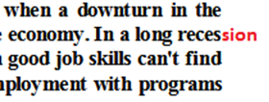
Clean-up Files
Complete or delete: words cut-off in scanning/ converting
Easiest in Microsoft Word
Convert files to text file (.txt).
Ctrl F
Round 2: Delete proper nouns, apostrophes, acronyms

Slide 11
Questions:
What is Lextutor?
What is your experience with Lextutor?

Slide 12
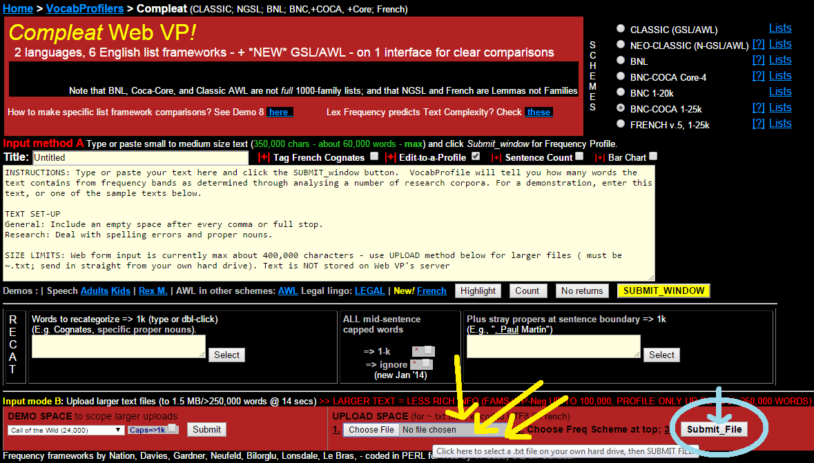
Step II. Analyze Your Corpus Data
Lexical Tutor’s Compleat Vocab Profile (http://www.lextutor.ca/vp/comp/)
- Generates frequency lists by comparison to COCA and BNC
Video Demonstration of Data Analysis
Notes:
Poll: Who has used Lextutor? What is it? What do you use it for commonly?
Note: Maybe Camtasia starts here? Put a hyperlink to Camtasia video

Slide 13
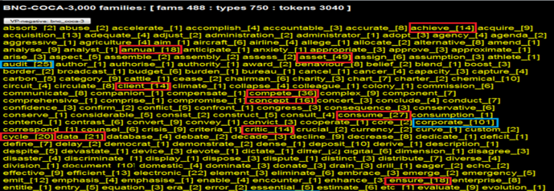
K3 Business Word List
2nd list generated =color-coded details of exactly what words are at each level
In this project:
Students are expected to know the K1, K2 and Academic word lists already
Vocabulary gap: many K3 words will be present in an American freshman business course
30 business-specific words from K3

Slide 14
Discussion
Which online vocabulary learning technologies have you used?
In your experience, what are the pros and cons of online vocabulary learning?

Slide 15
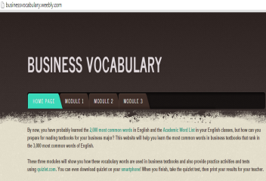
Business ESP Online Module
Contains three modules of ten words each
Presents vocabulary in authentic context
Provides pictures and definitions
Provides practice activities and assessments at the end of each module with Quizlet

Slide 16
Step III: Create Vocabulary Activities on Quizlet
Why use Quizlet?
Promotes learner autonomy (Runhaar, Van der Zande, and Ursella, 2012)
Portable
Improves reading & spelling
Provides pronunciation practice & assessment

Slide 17
Quizlet: Getting Started

Slide 18
Quizlet: Creating a Vocabulary Set

Slide 19
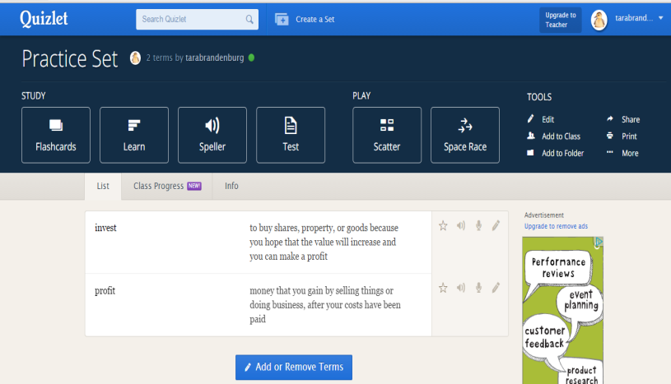
Quizlet: Editing and Using

Slide 20
Making a Website Using Weebly
Free domain name (URL)
No ads or optional ads for profit
Can create multiple websites
PC and smartphone friendly sites
Students can design websites linked to your account
Select from pre-designed themes
Easy to use and edit

Slide 21
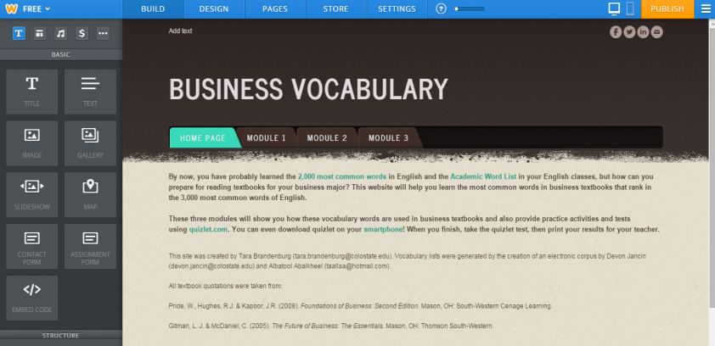
Weebly: Editing Your Website

Slide 22
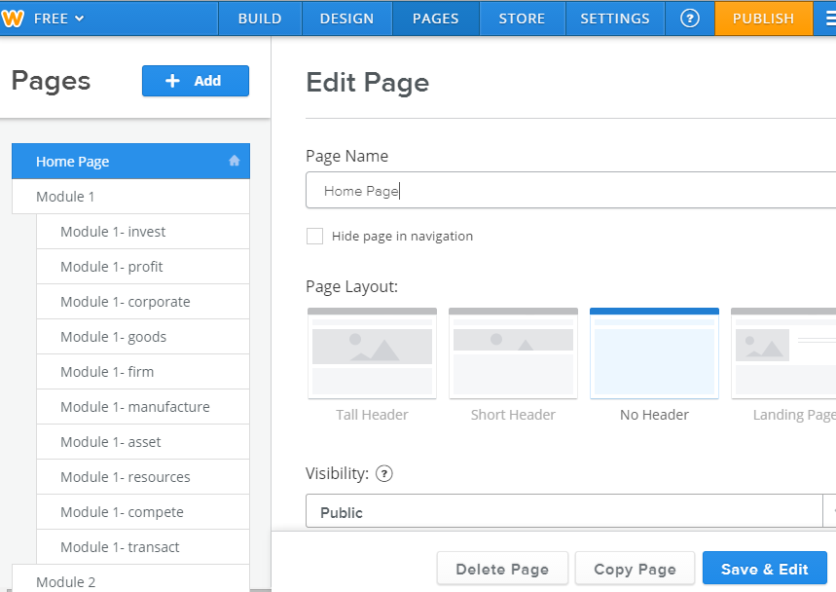
Weebly: Adding Pages

Slide 23
Using Your Website in Class
Pros
Cons
Independent study
Fun
Easy to share
Download on smartphones
Holding students accountable
Technological difficulties
Rote practice only

Slide 24
Discussion:
How could you use this in your class?
How could you adapt these technologies to your purposes?

Slide 25
References
Konstantakis, N. (2007). Creating a business word list for teaching
business English, ELIA, 7, 79-102.
McEnery, T., Xiao, R. & Tono, Y. (2006). Corpus-based language studies: An
advanced resource book. London: Routledge.
Nakata, T. (2008). English vocabulary learning with word lists, word cards
and computers: Implications from cognitive psychology research for optimal spaced learning. ReCALL, 20(1), 3.
Nation, P. (2001). Learning vocabulary in another language. New York:
Cambridge University Press.
Reppen, R. (2010). Using corpora in the language classroom. New York: Cambridge University Press.
Runhaar, G. J., van der Zande, S. M., & Ursella, E. G. E. (2012). Online
vocabulary learning for bilingual secondary school pupils: An intervention study with first-year learners at the Hermann Wesselink College. Retrieved from http://dspace.library.uu.nl/handle/1874/250577

Slide 26
Tara Brandenburg
Tara.Brandenburg@colostate.edu
Colorado State University
Devon Jancin
Devon.Jancin@colostate.edu
Colorado State University

